Slide 1


Community Association of Poundbury CIC
General Meeting
Damers Hall
6-8pm, October 7, 2026

Slide 2
Welcome!
Building a vibrant, inclusive
and supportive community
18 months on, we have much to share, and plans too!
Notes:
Add a picture

Slide 3
Doors open
Welcome, thanks & introduction – Zoe Bell (6-6.05)
Key note: Dorchester Town Clerk Charmaine Denny (6.05-6.15)
Progress review – All (6.15-6.30)
Formal business (6.30-6.45)
  - Financial report and Community Interest Summary: Jerry Cooke
  - New Treasurer
Plans for 2027 – All (6.45-6.55)
Your input matters: table discussions and volunteer sign-ups BREAK until 7.15
Stakeholder Q&A panel - Tim Wilmot moderating (7.15-7.55)
Next steps and close - Zoe Bell (7.55-8.00)
Agenda

Slide 4
Our mission
To foster a vibrant, inclusive and supportive community that enhances the quality of life for all in Poundbury, working collaboratively to address local needs, celebrate our community, and create meaningful opportunities for connection and growth
Building community spirit by supporting initiatives, events and local enterprises
Signposting and informing via the LovePoundbury Virtual Community Hub, weekly newsletter, socials and noticeboards
Raising awareness of what matters to the Poundbury community
Supporting initiatives that deepen community connections and local economic life

Slide 5
Thank you to our current volunteers!
Communications, led by Tim Wilmot: Jerry and Sue Cooke, Phil Hawkes, Peter Lee, Linda Roberts, Vivienne Westwood, Moira Young
Membership: Jerry and Sue Cooke, Peter Lee
Volunteering coordinator: Laura Hirst
Stakeholder Q&A process: Zoe Bell, Phil Hawkes, Tim Wilmot
Poundbury Good Things: David Kingman, Sue Cooke, Abi Scard, Tina Steele, Antonia Wilmot
Doggy bag dispensers: Rachael and Paul Coggins, Sheena Lee, Norman Reid, Linda Roberts
Love Poundbury Through Your Lens and events: David Kingman, Tim Wilmot
Meet Your Poundbury Neighbour: Laura Hirst, Cathy Gainer
Community organisation liaison: Lesley Clark
Poundbury Gardens Gold Card liaison: Jan Gray

Slide 6
Thanks to supporting businesses 2025-26
CAofP sponsorship and in kind support
Blanchards Bailey Solicitors
Casterbridge Chiropractic
CG Fry & Son Builders
Duchess of Cornwall Inn
Duchy of Cornwall
Edwards & Keeping
Frost & Co Accountants
Minuteman Press
Parkers Property
Rolls Landscaping
Sites by Elliott
Temple Wealth Management
Benefits to members
​Health and Wellbeing
Casterbridge Chiropractic: 25% off New Patient Appt.
Friths Opticians: 10% discount
Wellbeing Practice: 10% off services & events
​
Treating yourself
Brace of Butchers: 10% off (T&Cs)
Duchess of Cornwall: 15% off food & drink (T&Cs)
Monart Spa: 10% off (T&Cs)
The Florist of Poundbury: 10% off some items/services
Refreshing your home
Dovecote Trading Company: 10% off
Interior Tailors: 10% off furniture bought in store
Poundbury Gardens: Seasonal member offer
Rugs of Dorset: 10% off
Upcycle Interiors Ltd: £50 off for quotations >£500
Special occasions
Bridal Reloved: 10% off
Kirsten Sare: Makeup artist: 5% off
​Practical life
Hull Gregson Hull: 25% off sales and lettings fees
Igloo Mortgage: £100 off mortgage broker fees
MCS Laundry: 10% discounts on all services over £20.00
Plumbstop: 30% off
​
​

Slide 7
Our aims tonight
Review progress to date
Present new logo and look
Present our certified financials and community interest statement
Introduce new treasurer and ‘Poundbury Good Things’ lead
Share plans, get feedback, and recruit new volunteers
Engage you in the stakeholder Q&A to highlight community matters

Slide 8
CAofP milestones to date
2025
FOUNDATION PERIOD
Apr 2025
May 2025
Jul 2025
Sep 2025
Dec 2025
CAofP registered as a CIC
Virtual Community Hub goes live
Regular weekly newsletter launched
New membership drive
Noticeboards taken over and new income stream
Good Things team formed
New Love Poundbury cards
Doggy bag dispensers installed
First ‘Good Things’ developed
Inaugural General Meeting Stakeholder Q&A process piloted
Tech Tuesdays begin
Carols in the Engine Room
First donation to PiP
2026
BUILDING MOMENTUM
Jan 2026
Feb–Apr 2026
May 2026
Jun 2026
Sep 2026
Second GM — Q&A repeated
Through Your Lens competition launched
Love Local series begins
First AGM
Integration of PayPal
Members’ Shopping Eve at Poundbury Gardens
History Initiative launched
Donations drive to spring joiners
New logo
New Good Things range
Meet Your Poundbury Neighbour Socials
Items in gold are new since the last GM
Notes:
Gold text: new since last GM

Slide 9
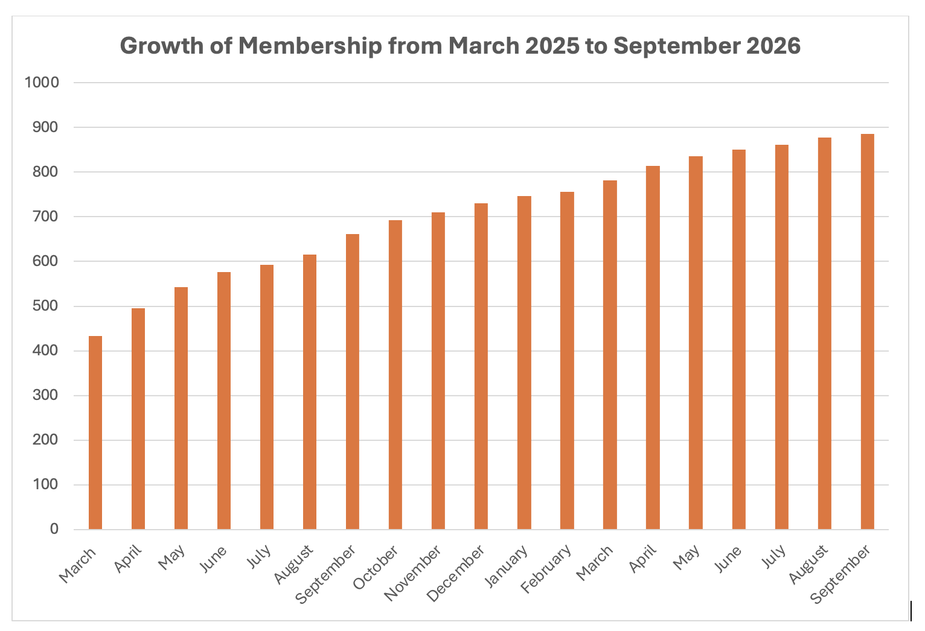
Key measures
~900 members—steady growth after initial surge
~30 active volunteers (core team of 10)
Communications platforms established: VCH, weekly newsletter, socials, community alerts
'Good Things’ established + new products, new look
Love Poundbury Through Your Lens photography competition launched, with 140 entries + products
7 doggy bag dispensers being used in locations across Poundbury (doggy bags dispensed ~2000)
22 questions addressed in stakeholder Q&A process
18 local businesses supporting member benefits
New logo!
New initiatives: Community Association History and Meet Your Poundbury Neighbour socials
New pay pal payment system and membership donation renewal process

Slide 10


Our new look
Updating “Love Poundbury”
Phasing in new look and feel across communications
Trademarking the new logo, underway
Thank you to CAofP member Peter Foster for the design

Slide 11
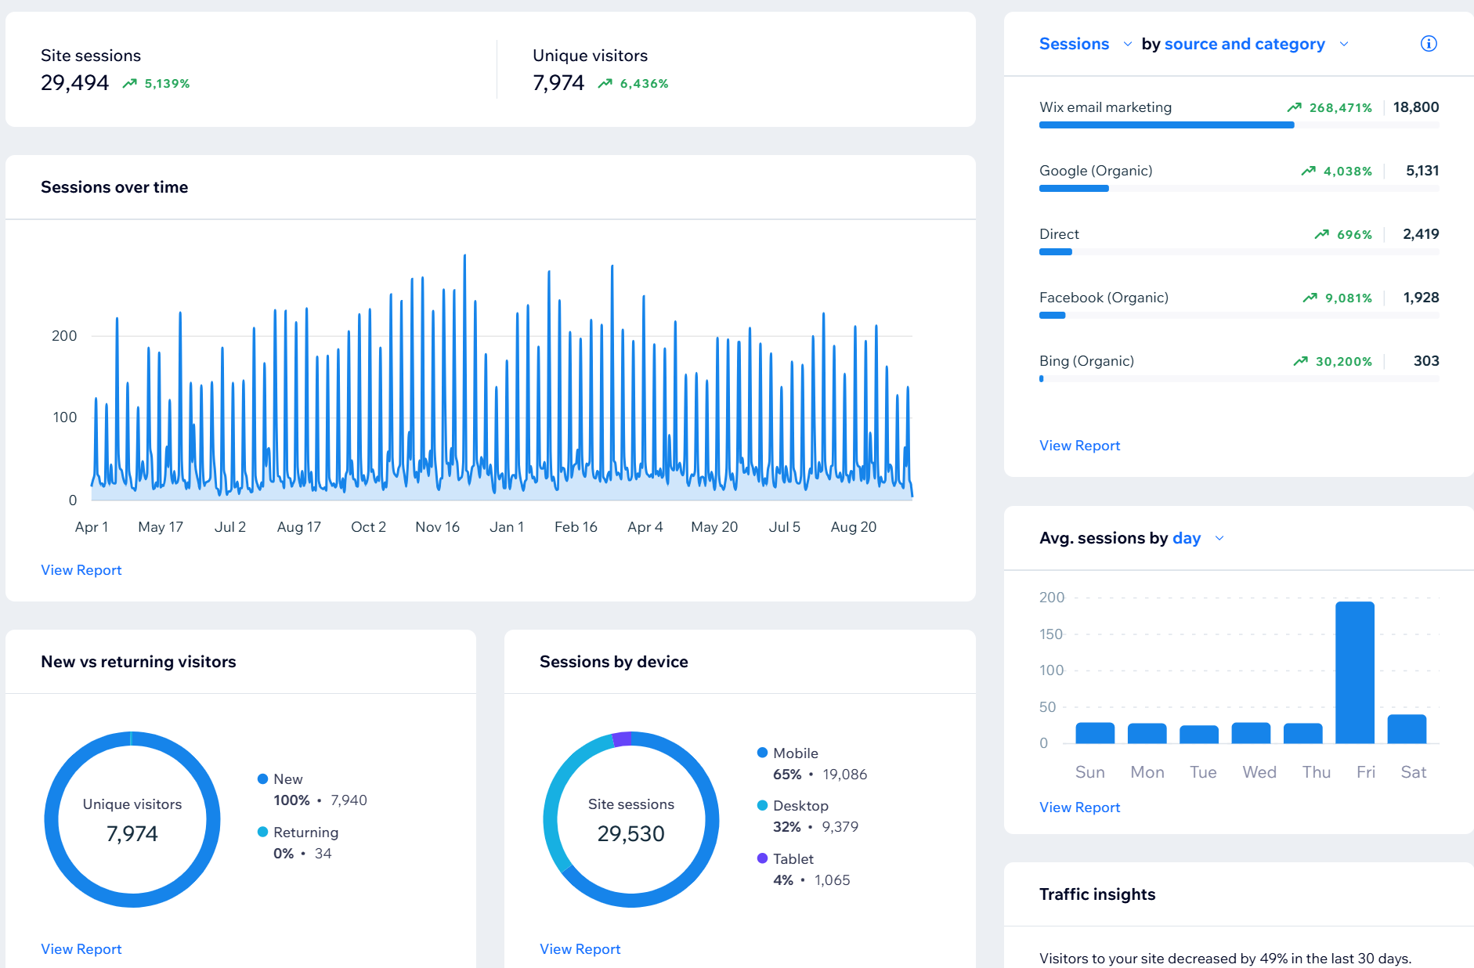
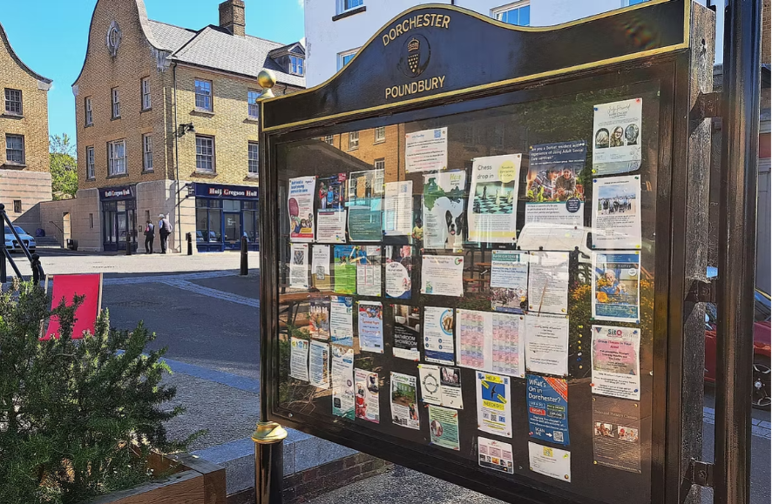
Communications: reaching all of Poundbury
LovePoundbury Virtual Community Hub & Notice Boards
60k page visits from 30k site sessions since launch
8K unique visitors, 65% mobile….optimised
130+ changes: inc Businesses, Discount Partners & new pages added, increased functionality for ease & simplicity…more to come!!
Packed with useful information and links
Sponsored with the Newsletter & generating revenue
8 noticeboards
800+ notices posted
£900 revenue in 12 months
Free to Residents, Charities and supporting businesses

Slide 12
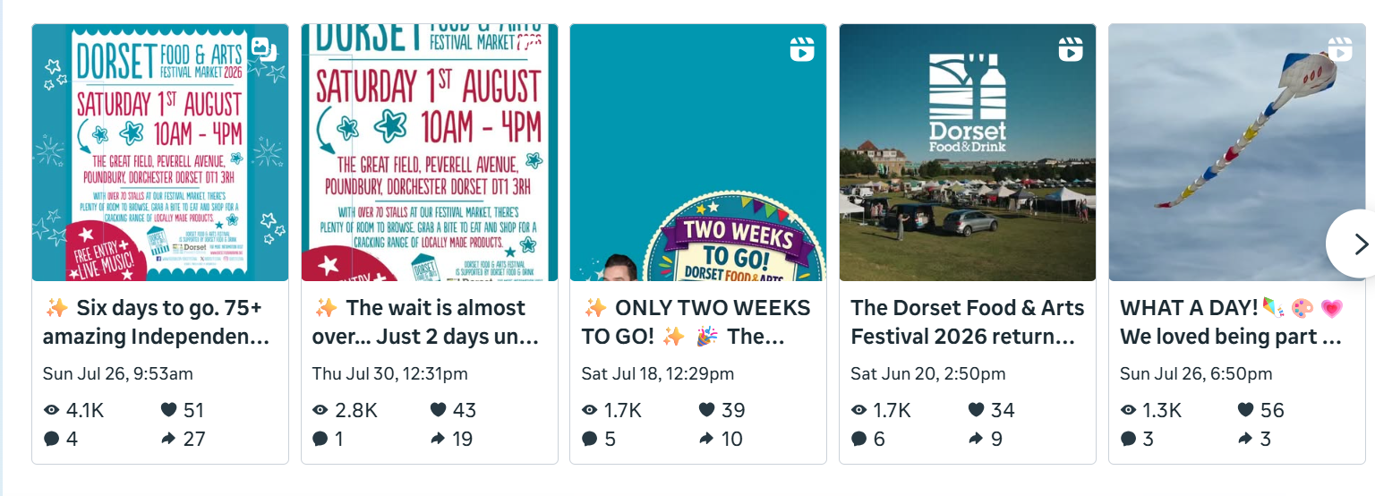
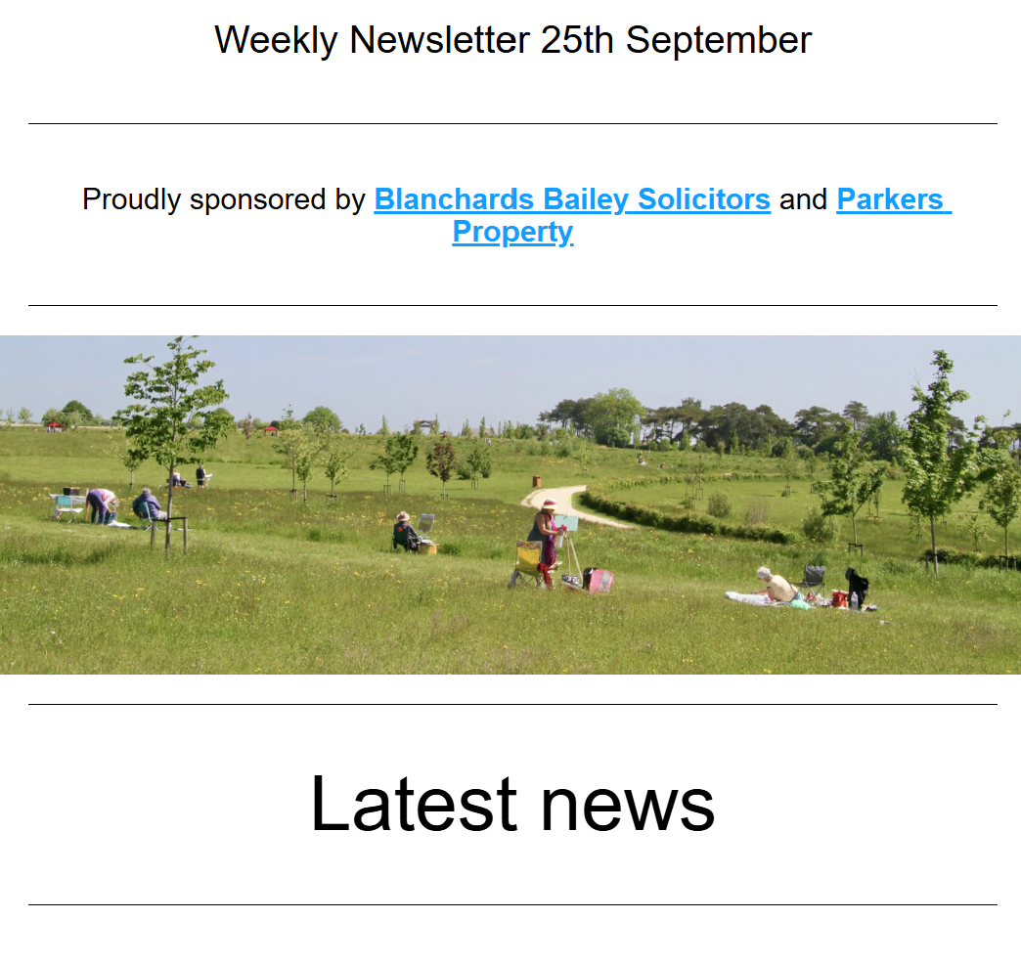
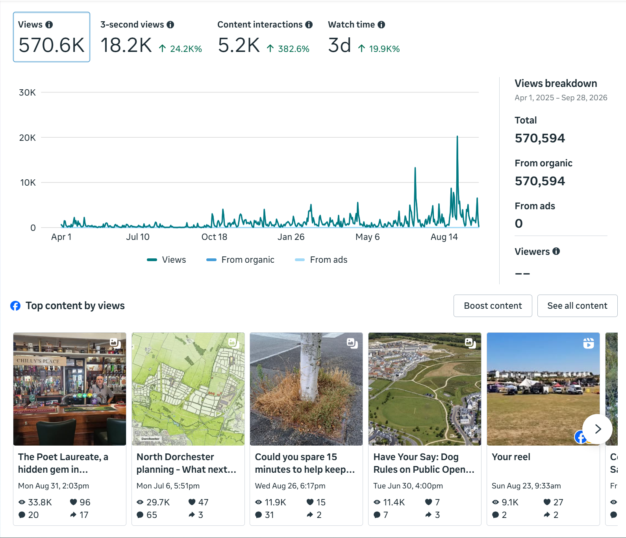
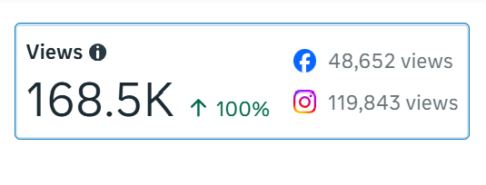
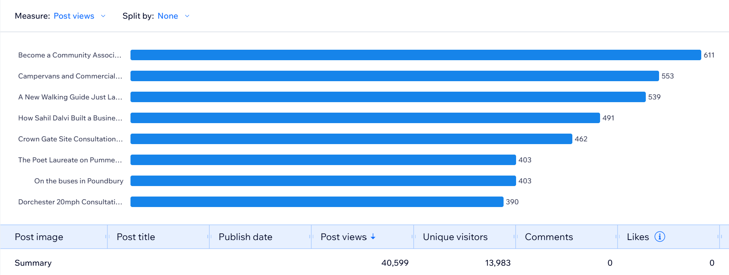
Communications: reaching all of Poundbury
Newsletter & Social Media
740K views across FB and Instagram
4.5K followers with 670+ new followers
Reaching far beyond Poundbury
Hugely varied appeal, updates and information to events and local interest
Working with local content providers and platforms to share and build momentum
1,450 subscribers to weekly emails 70% open rate
350+ unique stories with 40k+ reads: Across a huge spectrum, human interest, informative, supportive & fun…always local & always shared
New categories created

Slide 13
Virtual Community Hub: always on and current
130 updates since launch
A growing, accurate directory — 70+ new businesses, services, health providers & community groups added and kept current — plus 13 new member discount partners (from 5 to 18)
New pages and features — 3 major new pages: Sports & Play, Poundbury Good Things, Love Poundbury Through Your Lens, plus ticketed event functionality for our meetings and community events (GMs, Carols in the Engine Room, Shopping at Poundbury Gardens)
Simpler, smarter experience — 3 major pages significantly redesigned (Volunteering, Member Benefits, About), navigation simplified, forms improved for joiners and event sign-ups, sponsors integrated
Worthwhile Information — 13 new FAQs published; governance documents, policies kept current
Technology working harder — Secure shared drives, JotForms and PayPal integrated, contact segmentation used to deliver targeted email campaigns to the right people at the right time

Slide 14
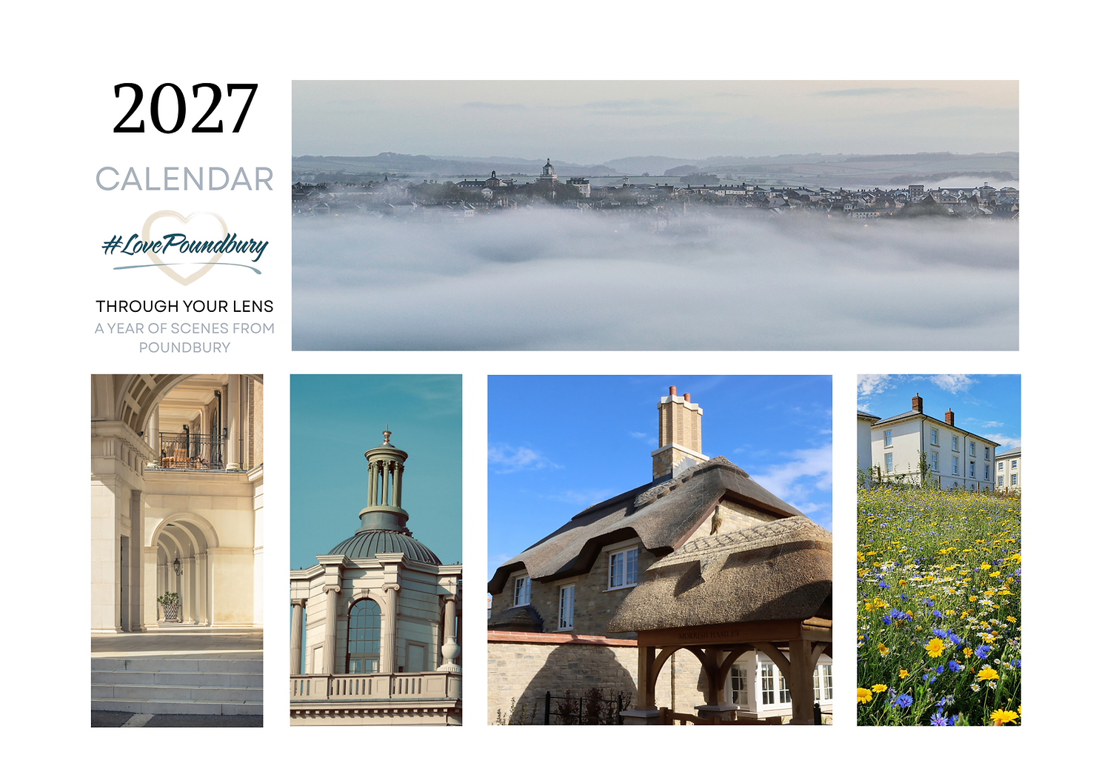
Love Poundbury “Good Things”
Our aims:
Celebrate Poundbury
Collaborate with local makers & artists
Raise funds for community initiatives: £1,000 donated to Talk About Trust’s initiatives at Pavilion in the Park
Plans: More good things for 2026-2027
  New: 2027 Through Your Lens Calendar and note cards
  New: The Poundbury Adventure Colouring Book
  New: China mugs and teatowels
Find “Good Things” across Poundbury & Dorchester
On sale today too!
Thank you: David Kingman, Claire Lunnen-Kay, Sue Cooke, Antonia Wilmot, Emma Taylor, Lorraine Beeton, Abi Scard, Peter & Cameron Foster
PLUS: Phil Reade, Dawn Russell, Moira Harries

Slide 15
Poundbury Good Things Raffle!
ORANGE: A lovely reusable hamper containing a canvas shopper & tea towel, Love Poundbury candle & soap from Rhubarb Candle Company, 2 ceramic mugs, 8 ‘Spirit’ Christmas cards, and a new calendar: value: £150!
PINK: A Love Poundbury autumn tote bag and wreath by Kay Kay
BLUE: Golf for 2 at Came Down Club (T&Cs), courtesy of Sue Cooke
Raffle tickets £2 each, selling at break

Slide 16

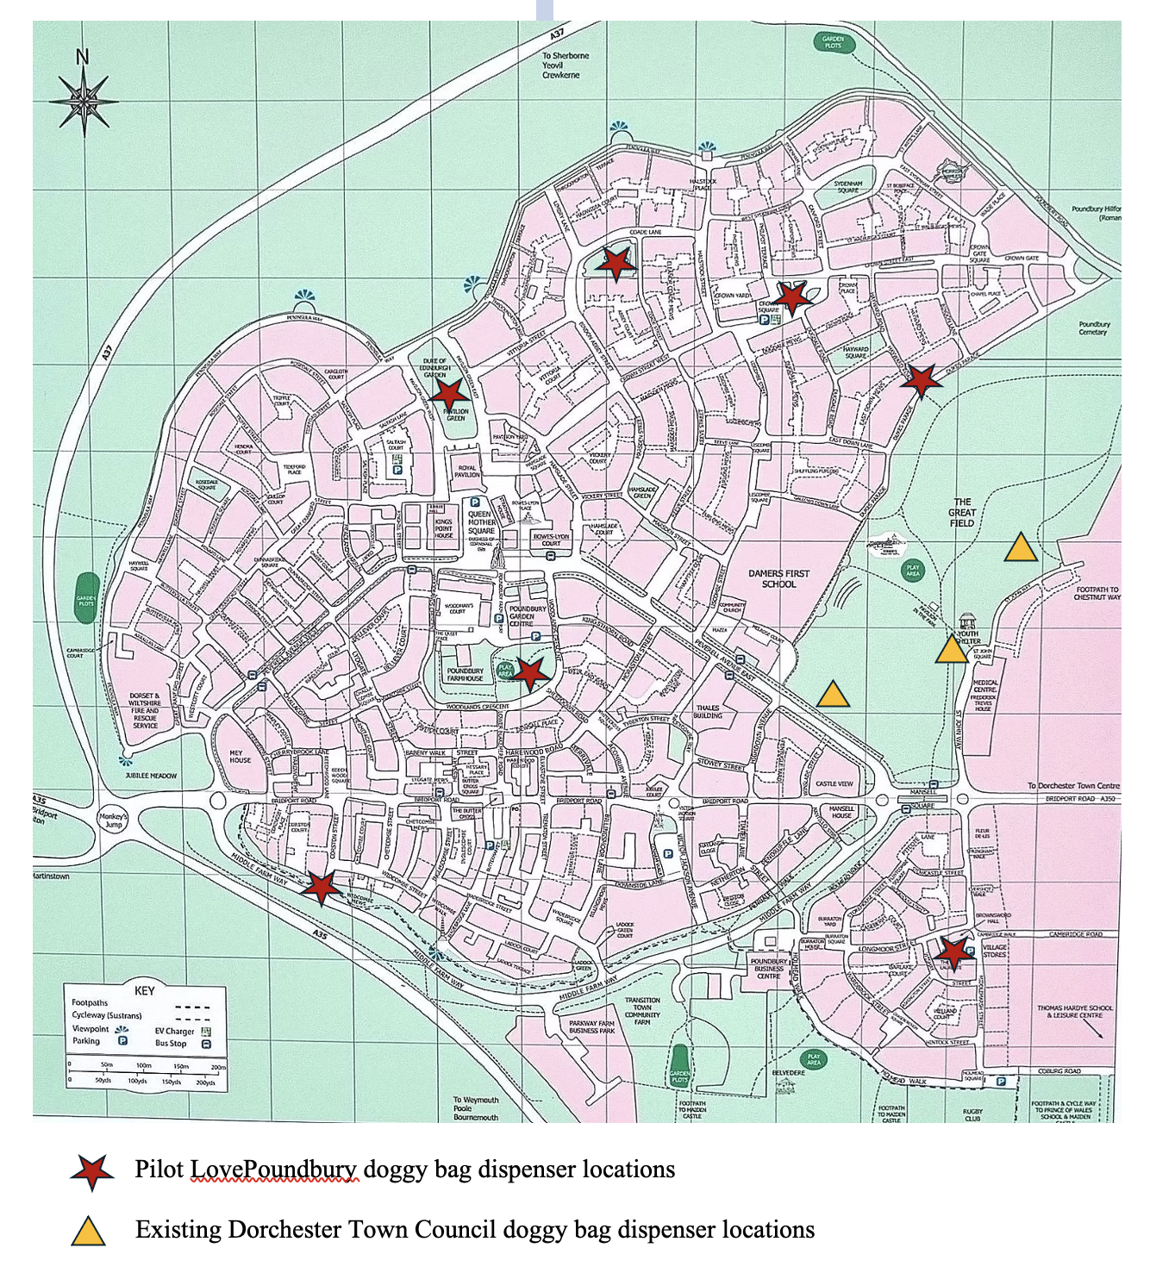
Our additional initiatives
Love Poundbury Through Your Lens
Organised by David Kingman, 140 entries across 5 categories, 3 local judges
Sponsored by: CG Fry, Duchess of Cornwall Inn, Duchy of Cornwall, Minuteman Press, Rolls Landscaping
Lovely exhibition & awards event at Duchess of Cornwall Inn, selected images made into calendar, postcards—profits to community causes
Please start snapping for 2027!
Doggy Bag Dispensers
7 locations across Poundbury, for use in doggy bag ‘emergency’
Supported by Rachael and Paul Coggins, Linda Roberts, Sheena Lee and Norman Reid Worked with MANCO and Duchy to select initial locations
Eiri Jones and Castle Vets funded
To suggest additional locations contact chair@lovepoundbury.org

Slide 17


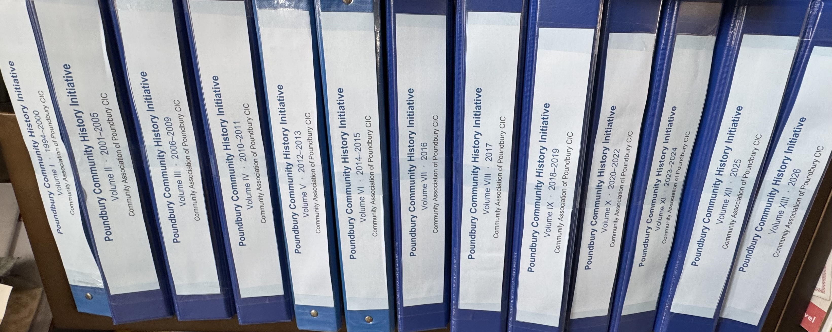
And more
Community Association Initiative
Documenting evolution of community association, from PRA in 1994 to CAofP at completion of Poundbury’s construction, determining lessons learned to inform new communities
800+ documents/materials collated and catalogued, more wanted!
Analysis underway, oral history phase with Dorset History Centre
Volunteers welcome to help
Meet Your Poundbury Neighbour
Informal social for residents new and current
4th Tuesday of the month
Being piloted at the Duchess of Cornwall Inn

Slide 18
Year 1 (2025/26) Financials
£12,011
TURNOVER
£10,793
EXPENDITURE
£1,218
SURPLUS
£8,195
NET ASSETS
Year 1 Income | Amount
Sales income | £6,180
Services income | £530
Advertising income | £555
Sponsorship income | £1,750
Donations | £2,987
Interest received | £9
TOTAL | £12,011
Year 1 Expenditure | Amount
Cost of sales (Good Things stock, net) | £4,320
Communications & website | £2,278
Hall rent & meetings | £681
Insurance, repairs & other admin | £1,101
Charitable donations | £1,000
Accountancy & bank fees | £818
Depreciation | £595
TOTAL | £10,793
Net assets at 31 March 2026: £8,195 (£6,977 c/f from PRA+ £1,218 generated) · Accounts certified by Edwards & Keeping

Slide 19
Year 2 (2026/27): Projected Income & Costs
Year 2 Income | Amount
Membership donations | £2,000
Poundbury Good Things | £6,000
Business sponsorship (comms) | £4,000
Community donations | £1,200
Photography competition (self-funded) | £1,000
Noticeboards | £800
TOTAL | £14,000
Year 2 Costs | Amount
Cost of sales (Good Things stock, net) | £4,000
Communications & website | £2,000
Hall rent & meetings | £500
Insurance, repairs & other admin | £1,200
Events | £1000
Accountancy & bank fees | £1,000
Depreciation | £600
TOTAL | £11,700

Slide 20
AGM formal business:
CIC Community Interest Summary Year 1
How the community benefited:
Communications and information
PGT: collaborated with 4 local artists and makers, profits to community causes
Community donation to support youth and community programmes: £1000
Doggy bag dispensers and litter picker support
Stakeholder Q&A: giving the community a voice with decision-makers
LPTYL: celebrating local talent and building community pride
16 membership benefits with local business
Filed with Companies House
All activities of the Community Association of Poundbury CIC are for the benefit of the community of Poundbury—residents, workers,volunteers and businesses—and no surplus is distributed to members or directors

Slide 21
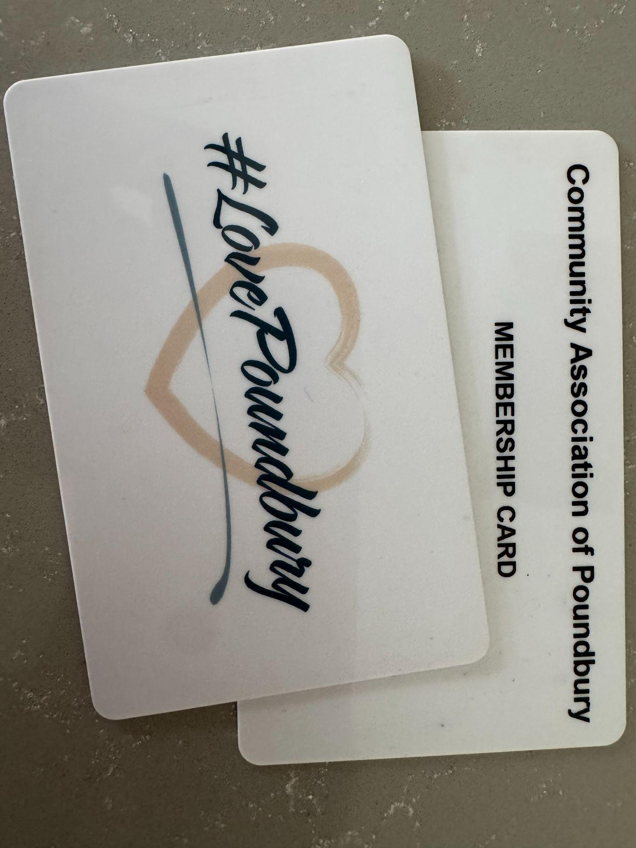
Membership donations
Membership remains free, and donations voluntary
Plastic membership cards mean annual renewals not necessary
Membership donations go towards running costs, including website, newsletter, and events
Quarter Joined | Joiner Class | Outreach Month
Q2 2025 | Spring joiners | June 2026
Q3 2025 | Summer joiners | Sept 2026
Q4 2025 | Autumn joiners | Dec 2026
Q1 2026 | Winter joiners | Mar 2027
Two easy ways to donate:
BACS bank transfer
PayPal

Slide 22

New Treasurer: Melanie-Kate Fowler
Lives in Poundbury with her family, running her own bookkeeping and virtual assistant business
Over 25 years' finance and governance experience, including as a Finance Director & Company Secretary, with hands-on knowledge of Companies House and HMRC compliance
Previously Treasurer & Secretary for a charity, bringing first-hand experience of the Treasurer role in a voluntary-sector setting
Currently studying social sciences, politics and public policy with the Open University
Passionate about community wellbeing, resilience and building strong, connected local communities — as a mum to children of varying ages, and someone keen to contribute more practically to the place she lives
Oversees our day-to-day finances, including bookkeeping, bank reconciliation, and maintaining accurate financial records
Prepares regular financial reports and budgets for the board, and presents accounts to members at General Meetings
Ensures compliance with CIC reporting requirements, including statutory filings to Companies House and any relevant regulatory bodies
Advises board on financial planning, helping guide decisions on spending, fundraising, and resource allocation

Slide 23
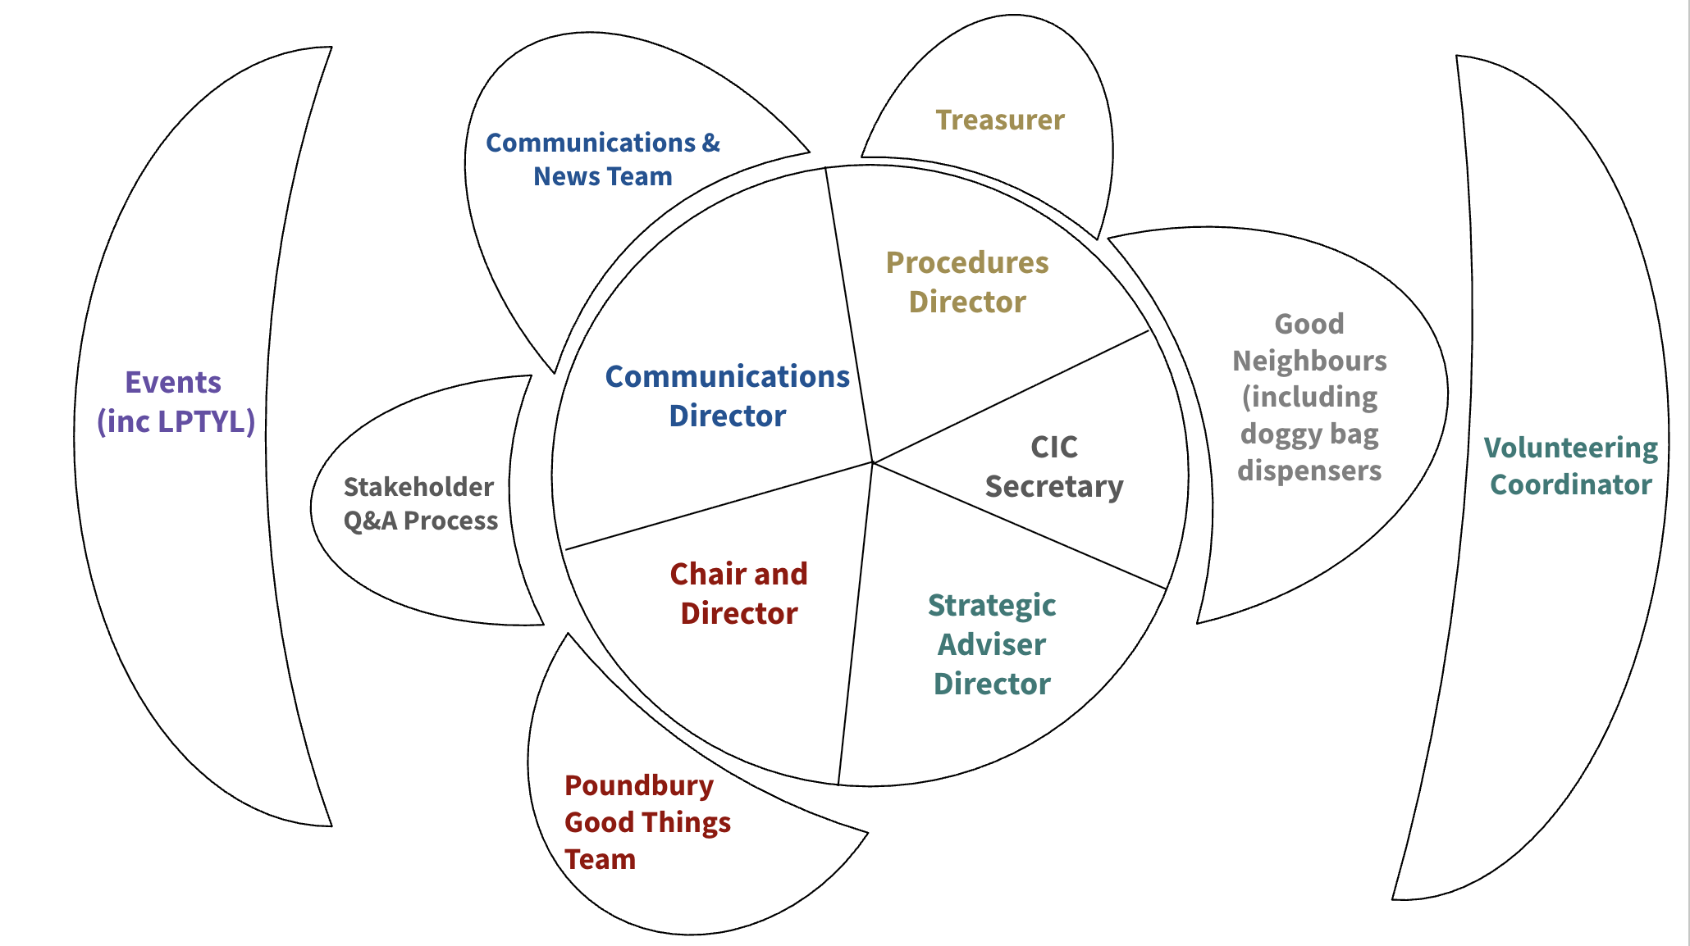
Team composition

Slide 24
We need you to shape Poundbury’s future
Volunteer status
30 active volunteers since establishment
4 volunteers passed to other local groups
12+ specialist skills now supporting our work
New volunteer policy
Volunteers needed for:
Leadership roles: Good Neighbours Initiative
Operations support: digital comms, noticeboards, events, membership management
Oral history element of Community Association History
Even an hour a week in the right place makes a real difference!
How to sign up:
Table sign up cards
Speak to us
Visit Lovepoundbury.org
Email volunteering@ lovepoundbury org

Slide 25

2027: growing what works, together
We will continue to consolidate what works
We will launch new initiatives only if capacity grows
We will continue to build our sustainable financial model, including through sponsorship
We will prioritise recruiting volunteer leaders
We will continue to demonstrate measurable impact

Slide 26
2027: Draft Plan
Maintain focus on communications
Continue with 2 x year GMs and Stakeholder Q&A
Phase in new logo and look
Attract more volunteers, esp. initiative leaders
Continue to develop “Good Things”
Hold more Meet Your Poundbury Neighbour socials
Expand doggy bags?
Progress Community History Initiative
Develop ”Good Neighbours”
Other?

Slide 27

Your input matters
What should be priorities for 2027?
What new initiatives would you like to see in future?
What would you volunteer for?
Please comment, ask questions, and help refine the association’s work
Notes:
Zoe to ask people to consider what they have heard and complete the form on the table about priorities and volunteering opportunities.

Slide 28
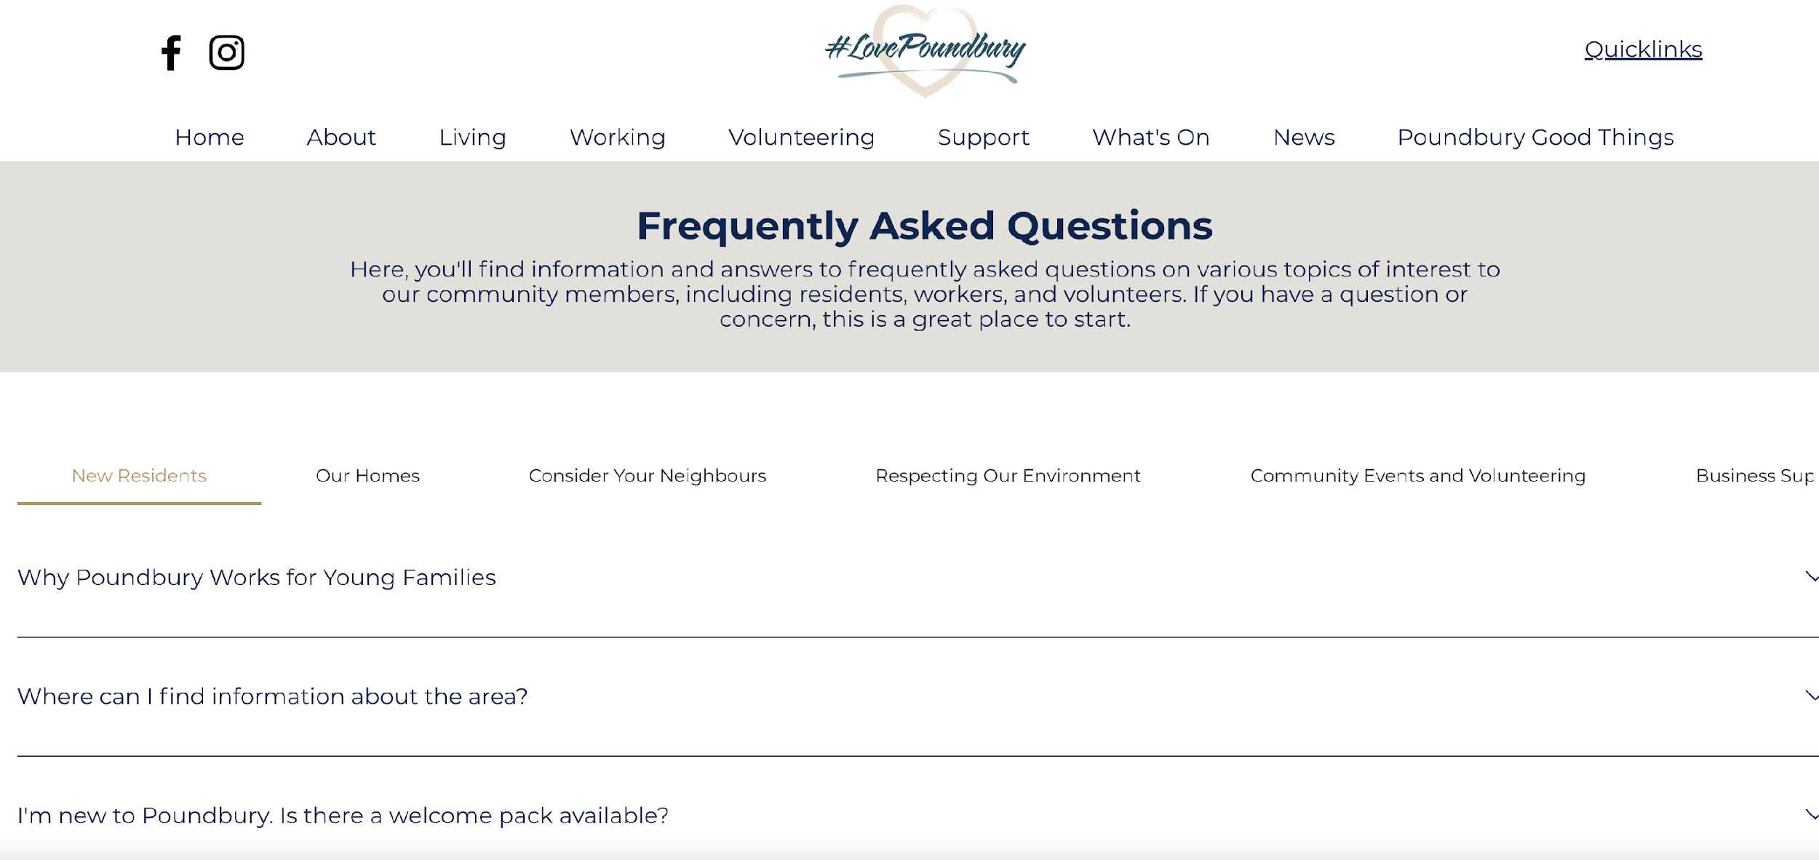
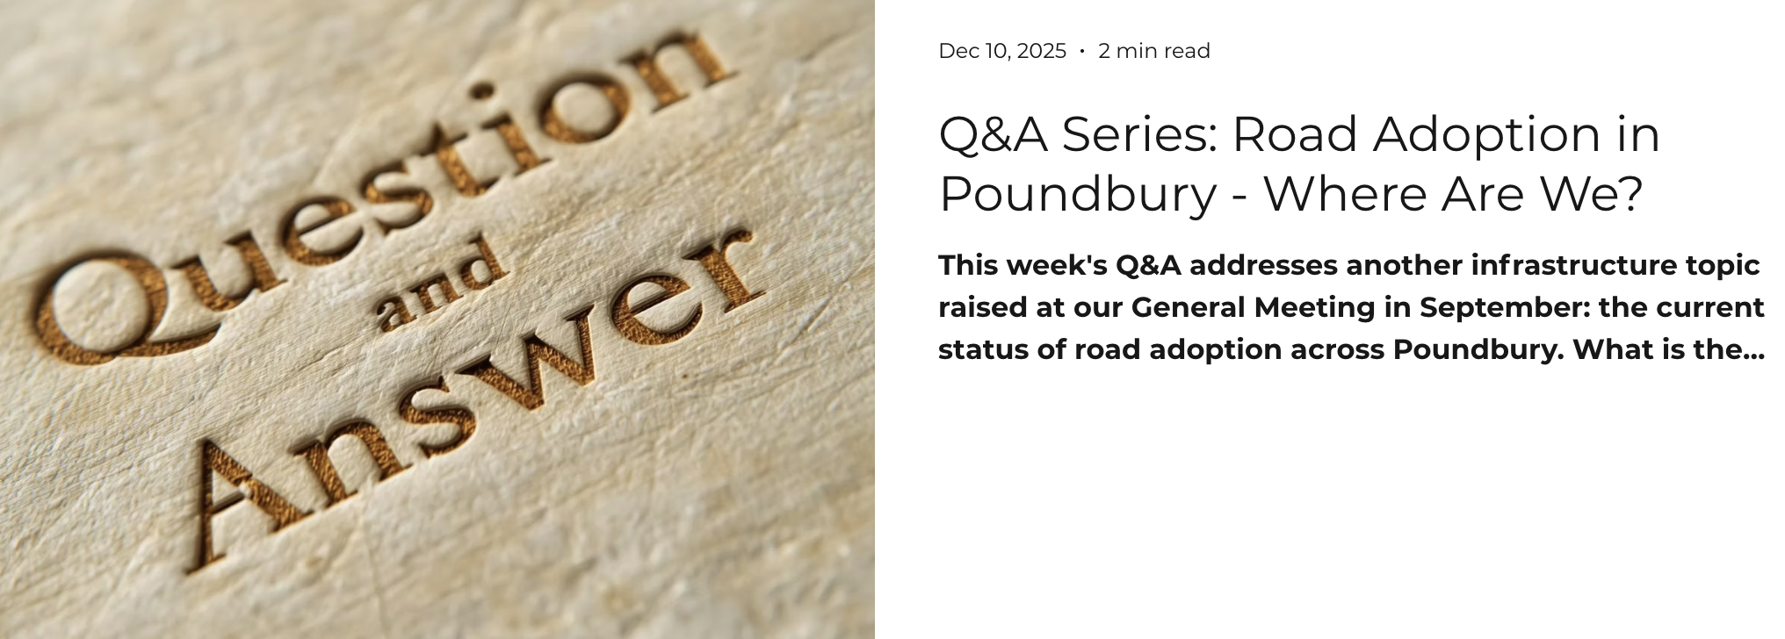
Stakeholder Q&A session
Questions put forward by community in advance of meeting will be answered first
If time allows, we will call for questions from the floor
Otherwise, please submit additional questions to info@lovepoundbury.org
Relevant answers will be consolidated and posted online
  FAQs in Support & Guidance on the VCH
  Newsletter articles

Slide 29
Thank you to the stakeholder panel
Moderator: Tim Wilmot, Community Association of Poundbury
Zoe Bell, Community Association of Poundbury
Councillor Richard Biggs, Dorset Council
Jason Bowerman, Duchy of Cornwall
Sahil Dalvi, Owner of Crossroads Cafe, 100 Giggles, and Buttermarket Postoffice
Charmaine Denny, Dorchester Town Council
Councillor William Gibbons, Dorchester Town Council
Jane Goodwin, Local police
Ryan Holmes, MANCOs
Citizens Advice Bureau? Jane Goodwin, Steve Morton?

Slide 30
Terms of engagement
Respect
No personal attacks
Time limits
Solution-focused - emphasis on next steps and accountability, not blame
No interruptions - allow speakers to complete responses
We will address questions sent in advance first

Slide 31
Questions: key themes
Maintenance of roads and public spaces
Infrastructure
Road adoption
Planning and development
Use of public spaces
Parking, speeding, road safety
Businesses in Poundbury
Community safety
Dog-related
Enforcement of stipulations

Slide 32
Thank you to our community for your support, engagement and vision for Poundbury's future

Slide 33


Get involved: every action counts
Volunteer: speak to us tonight!
AND/OR
Support
Renew Membership: voluntary donation via lovepoundbury.org
Spread the word: tell a neighbour who doesn’t know about us
Supporting business: introduce potential partners or just shop local
Attend events: support community activities
Send us a story: whatson@lovepoundbury.org
Tell us what matters: your feedback shapes what we do
We Need You!
The success of this association depends on community participation and volunteer commitment
Stay connected
Website: lovepoundbury.org
Newsletter: Weekly updates
: @LovePoundbury
: @LovePoundbury
info@lovepoundbury.org
Annual General Meeting
May 2027 TBC

Slide 34
Building Our Community Together
Working collaboratively to address local needs, celebrate our community, and create meaningful opportunities for connection and growth
Thank you for being part of Poundbury's future

